Slide 1

Time Series Forecasting
UA DataLab
Shravan Aras, Ph.D.
(3-18-2024)

Slide 2
Outline
What is timeseries data
Different types of timeseries data
Forecasting – Definition and Illustration
Forecasting methods for stationary
Forecasting methods for non-stationary
Using RNN for forecasting
Using LSTM for forecasting

Slide 3
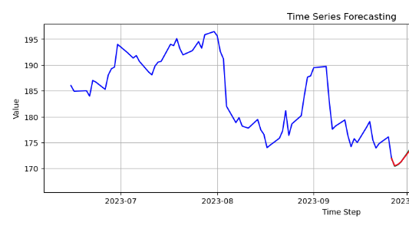
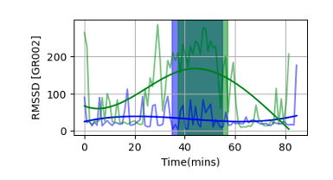
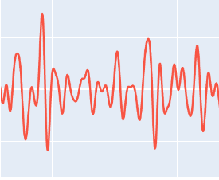
What is timeseries data?
Sequence of data points
Successive points in time
Preferably with a regular period / regular interval
Stock Market
HRV
BVP

Slide 4
Characteristics of time series data
Temporal Dependence –
Values are not independent. Y(t) is related to a previous value Y(t-n).
Seasonality –
Periodicity or having a time periods – seconds, minutes, hours, years or decades.
Trend -
DC component or mean, upward or downward trend over time.
Noise -
Variability in the time series.

Slide 5


Is this time series data?
Tossing a coin multiple times?
H T H H T T
Dice roll
3 2 1 1 1 6 2
Random Walk
Y(t) = Y(t-1) + Random
This Photo by Unknown Author is licensed under CC BY-SA
This Photo by Unknown Author is licensed under CC BY-NC

Slide 6
Is this time series data?
Tossing a coin multiple times?
H T H H T T
Dice roll
3 2 1 1 1 6 2
Random Walk
Y(t) = Y(t-1) + Random
This Photo by Unknown Author is licensed under CC BY-SA
This Photo by Unknown Author is licensed under CC BY-NC

Slide 7
Types of Timeseries
Stationary Time Series
Mean, variance and autocorrelation are constant
Fluctuates around a constant mean and variance
Non-Stationary Time Series
Statistical properties change over time.
They have –
Trending -> Mean changes
Seasonality -> Periodic change

Slide 8
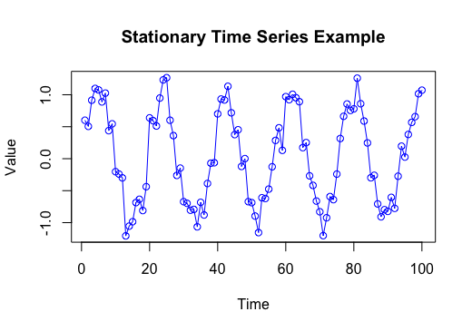
Examples of the 2 Types
Stationary
Periodicity from a sine wave
Fluctuates around the mean of 0 and std = 0.2
Mean and variance remains same throughout
Observe we don’t see any DC component or trend overtime.
Generated in R – code/ stationary-example.R

Slide 9
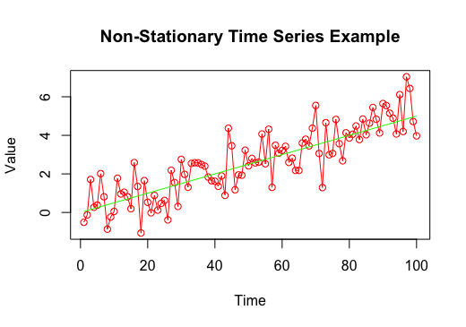
Example of the 2 Types
Non-Stationary
Has a linear trend with slope of 0.05
Combines the linear trend with noise data
Observe how mean / DC component of the signal changes over time.
Makes it harder to build a forecasting model since the mean changes.
Most signals in real-life.
Generated in R – code/non-stationary-example.R

Slide 10
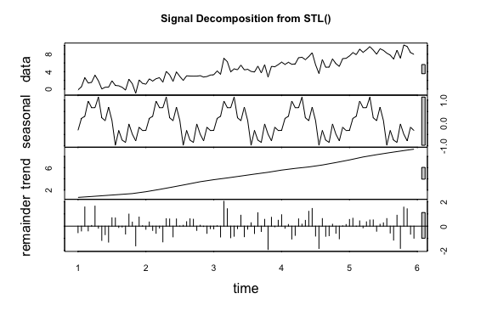
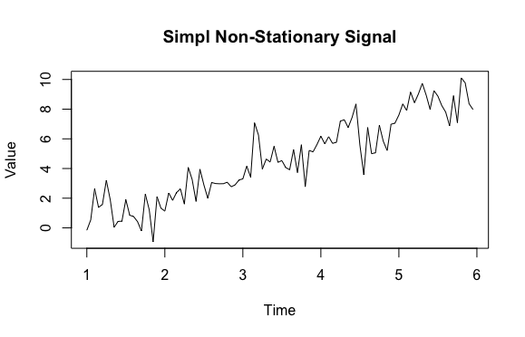
Decompose the time series.
Using the STL() method in R to isolate seasonality, trend and irregular
Generated in R – code/decompose.R

Slide 11
Testing stationarity / lack of.
Do a visual inspection → Plot your data and stare at it.
Decompose the signal as shown earlier.
Use domain knowledge, is the unkown system generating this likely to be stationary or not.
Use statistical tests -
ADF (Augmented Dickey-Fuller) Test
KPSS (Kwiatkowski-Phillips-Schmidt-Shin) Test

Slide 12
Statistical Tests
ADF
Null : Unit root is present in AR model → implies non-stationarity
Simply → Checks for linear trend + dependence on previous
If trend is present but no dependence → non-stationary
P < 0.05 → We reject the null hypothesis → signal is stationary
R package : “tseries”, adf.test()
KPSS
Null : The signal is stationary
P < 0.05 → We reject the null hypothesis → signal is non-stationary
R package : “tseries”, kpss.test()

Slide 13
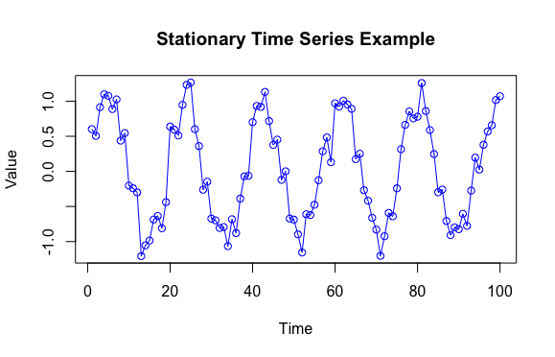
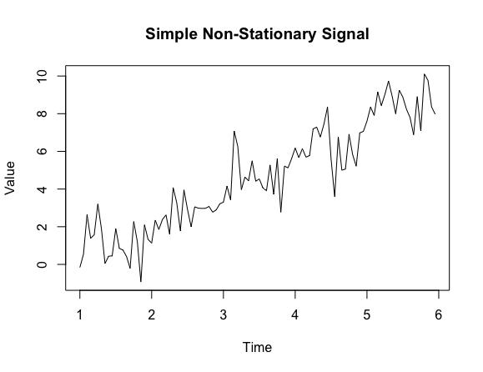
Examples
Augmented Dickey-Fuller Test
p-value < 0.01
alternative hypothesis: stationary
KPSS Test for Level Stationarity
p-value > 0.1
Augmented Dickey-Fuller Test
p-value < 0.03
alternative hypothesis: stationary
KPSS Test for Level Stationarity
p-value < 0.01
Generated in R – code/statisticaltest.R

Slide 14
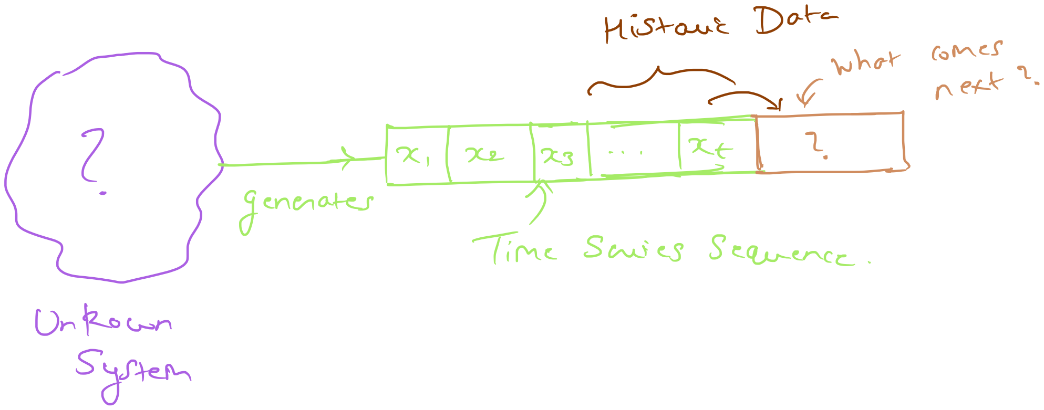
Problem Illustration
Given a sequence of data-points, we must predict what comes next.

Slide 15
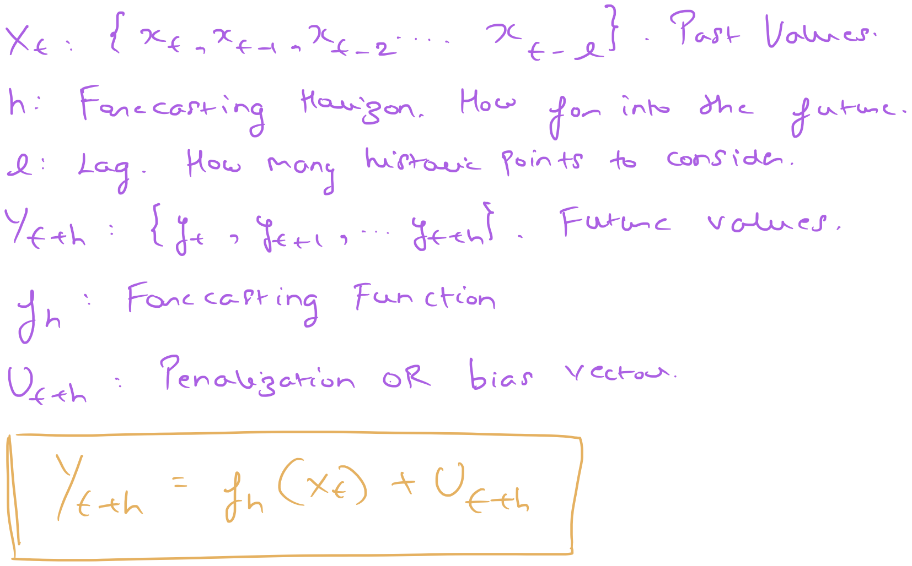
Problem Formalization

Slide 16
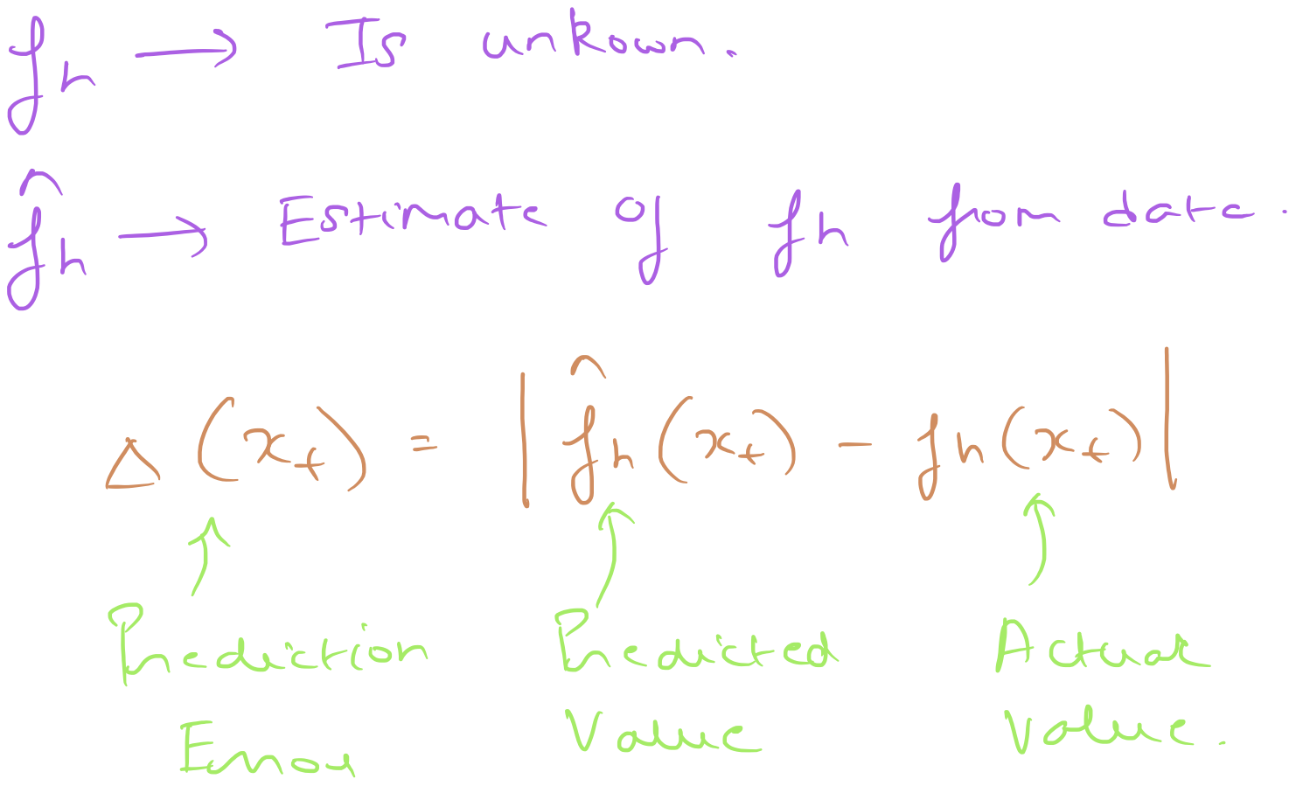
Formulation of prediction accuracy

Slide 17
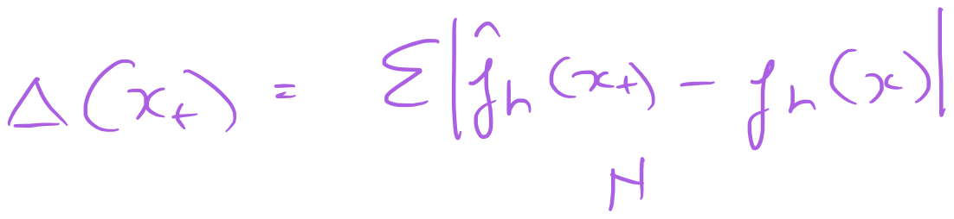
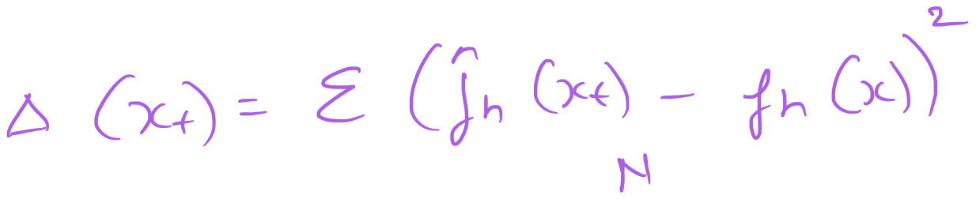
Common Errors – L1 and L2 norm
Mean Absolute Prediction Error (MAPE)
Mean Squared Prediction Error (MSPE)
L1
L2

Slide 18
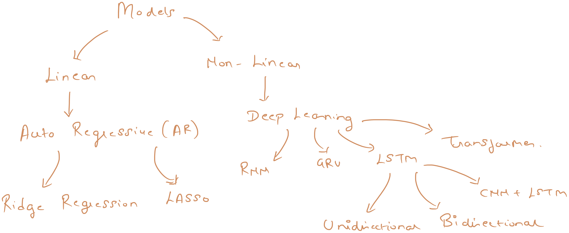
Forecasting options

Slide 19
AR – For Stationary Signals
Fundamental Auto-Regressive Model
Regresses on itself.
AR(p) -
P is the order of the model, how far back
AR(1) – Look one timestep behind
R can find the best order using a metric like AIC
R Package : forecast
Method : ar() to fit the model. Or auto.arima()

Slide 20
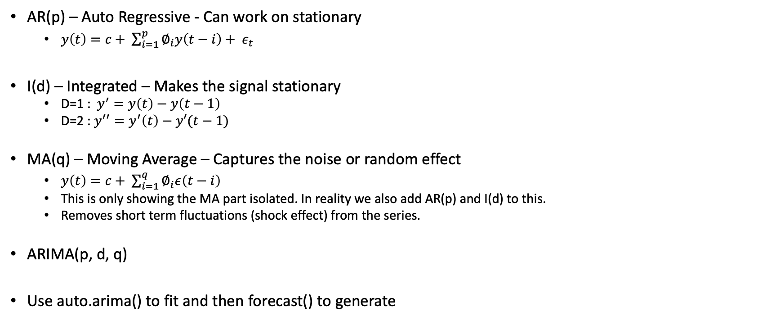
ARIMA – For Non-Stationary Signals
AR(p) – Auto Regressive - Can work on stationary
$y\left(t\right)=c+ \sum_{i=1}^{p}{∅_{i}y\left(t−i\right)+ ε_{t}}$
I(d) – Integrated – Makes the signal stationary
D=1 : $y^{′}=y\left(t\right)−y\left(t−1\right)$
D=2 : $y^{′′}=y^{′}\left(t\right)−y′(t−1)$
MA(q) – Moving Average – Captures the noise or random effect
$y\left(t\right)=c+ \sum_{i=1}^{q}{∅_{i}ε\left(t−i\right)}$
This is only showing the MA part isolated. In reality we also add AR(p) and I(d) to this.
Removes short term fluctuations (shock effect) from the series.
ARIMA(p, d, q)
Use auto.arima() to fit and then forecast() to generate
Notes:
Properties of white noise –
Mean of 0
Constant variance across all t
No auto-correlation at any lag factor. The Et terms are independent of each other.
Model fitting process uses the residual error from the AR process to calculate Et, and then find the weights such that the residuals Et will behave like white noise.

Slide 21
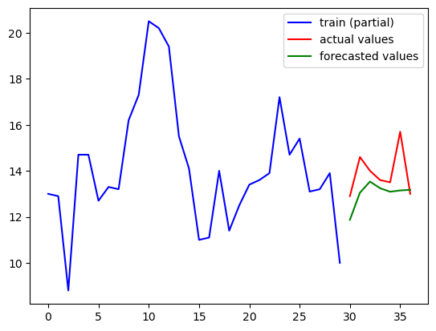
Python Example for AR
Refer to https://github.com/nextgensh/datalab-teaching-timeseries/blob/main/autoregression.ipynb

Slide 22
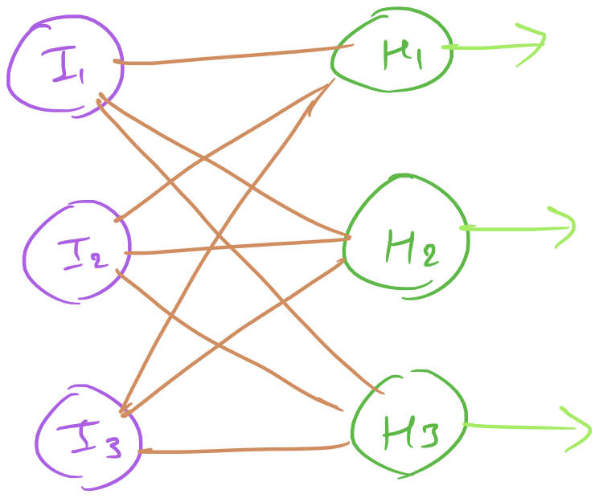
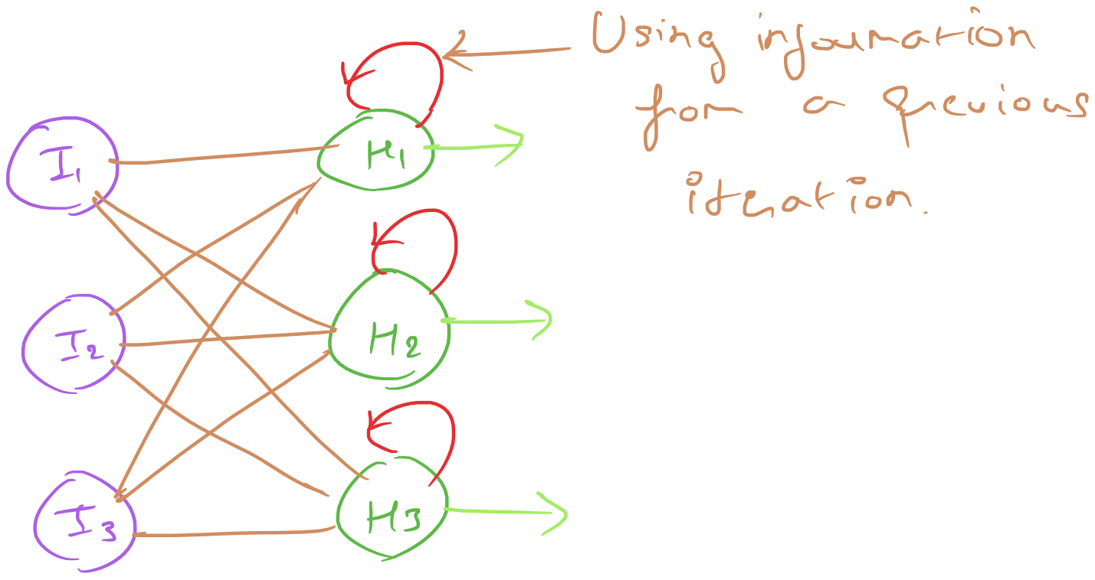
RNN – Recurrent Neural Networks
Feed forward neural networks
Recurrent neural networks

Slide 23
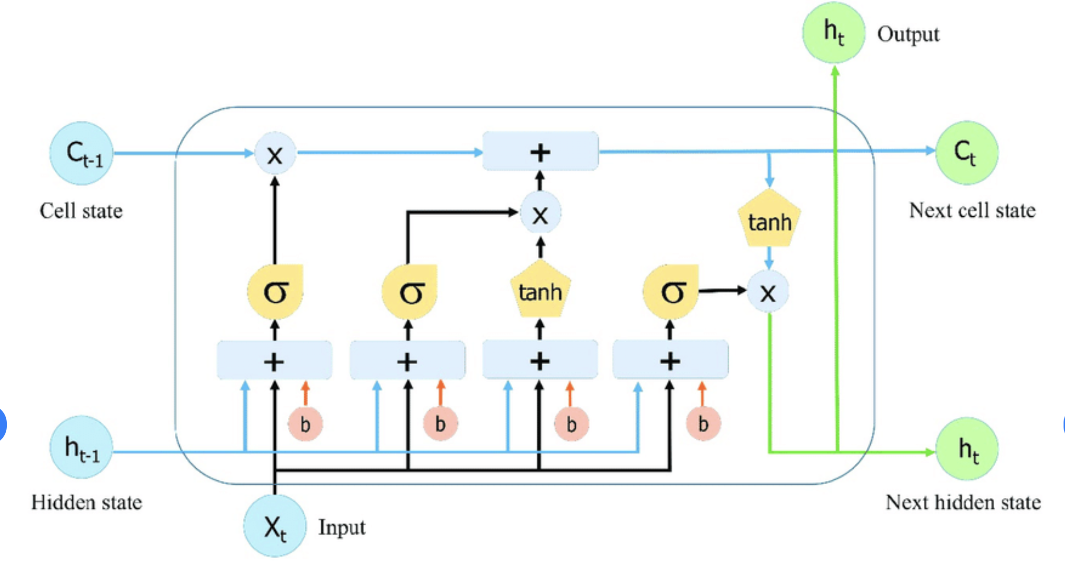
LSTM (Long-Short Term Memory)

Slide 24
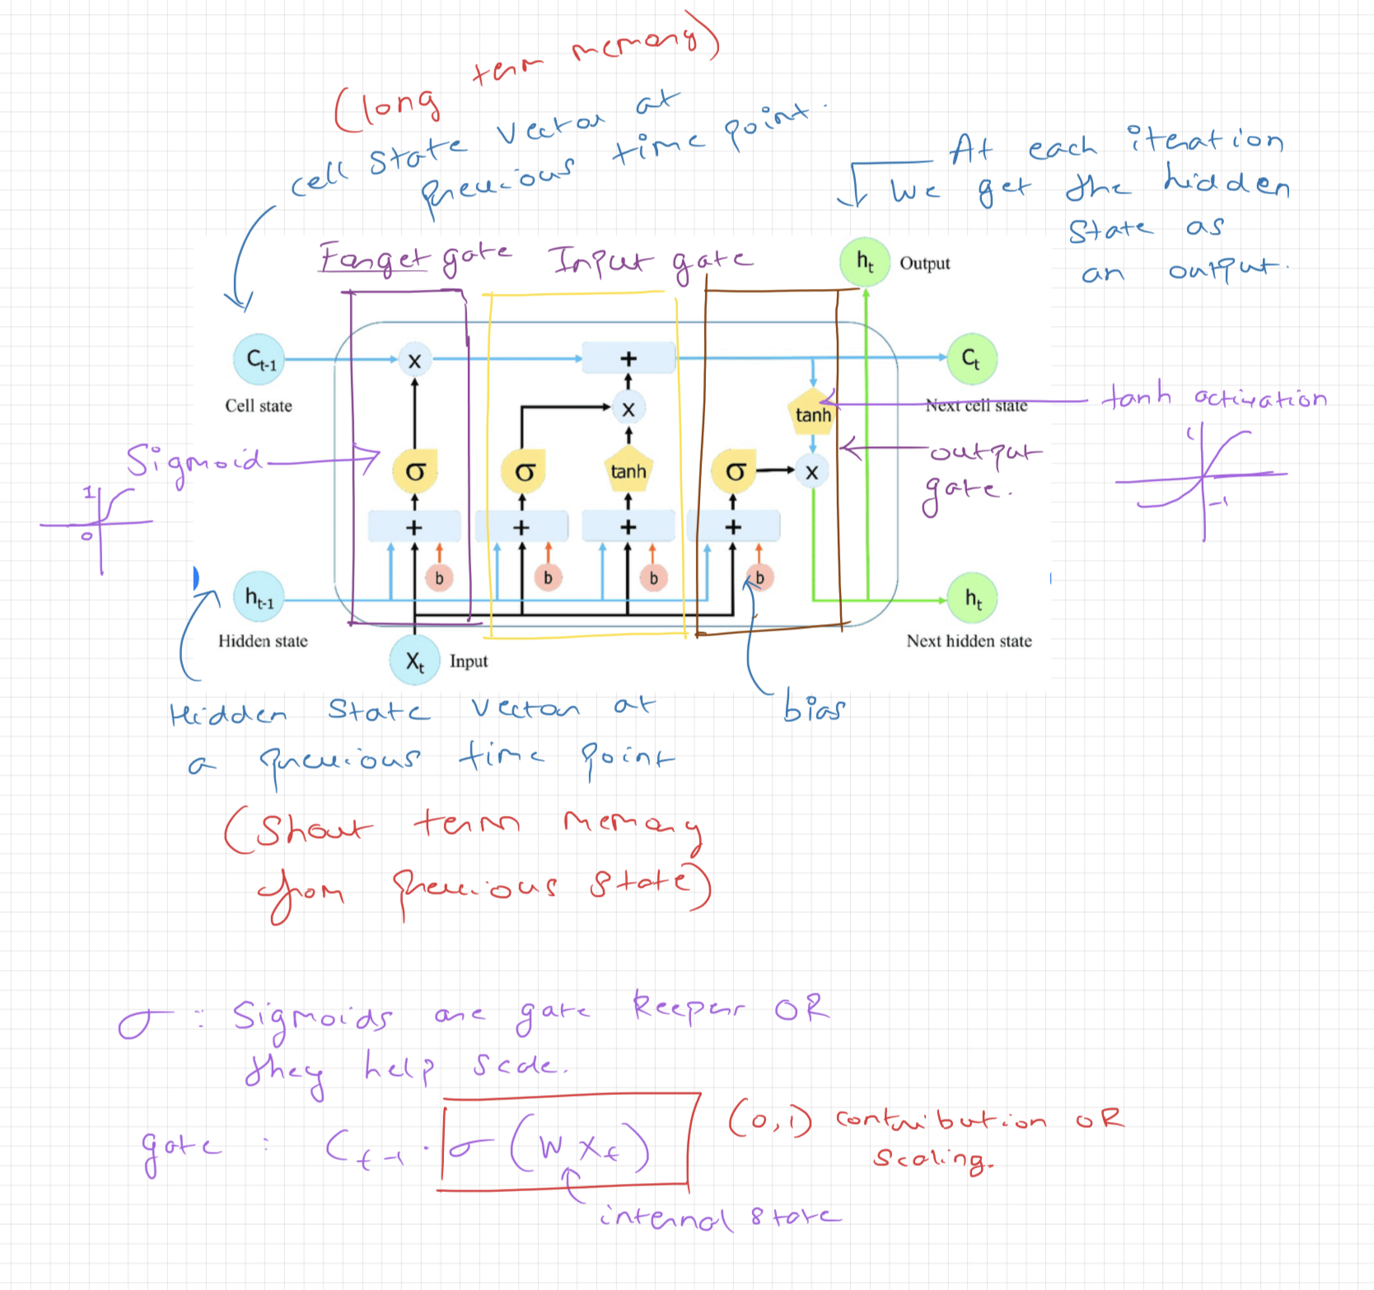
LSTM Annotated

Slide 25
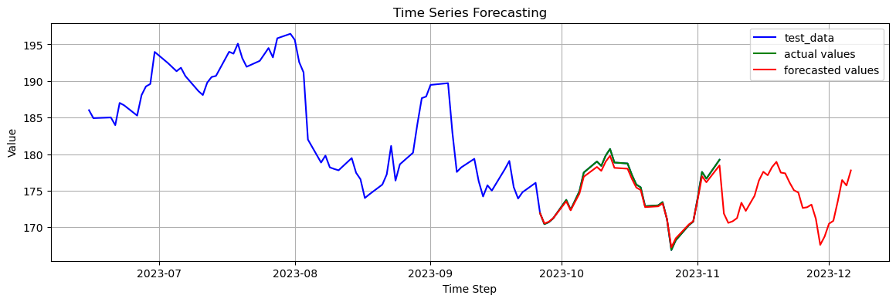
Python Example
Refer to https://github.com/nextgensh/datalab-teaching-timeseries/blob/main/basicLSTM.ipynb

Slide 26
Thank You
Check out the workshop page for notebooks and notes.
Contact me if you have any questions – shravanaras@arizona.edu

